Slide 1
Interface Example
Lab 8

Slide 2
Course Teacher Dr. Shahriar Mahbub, Professor Tanvir Rouf Shawon, Lecturer Ashna Nawar Ahmed, Lecturer

Slide 3
Suppose we are making a website where different cooking games can be played. All games do some common things which must be followed.

Slide 4
Basic Activities
Preparation
arrangeIngredients
prepareIngredients
completePreparation
Assembling
Selling

Slide 5
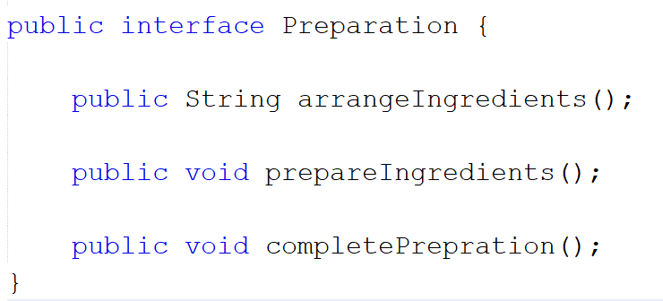
Create an Interface for the first Activity.

Slide 6
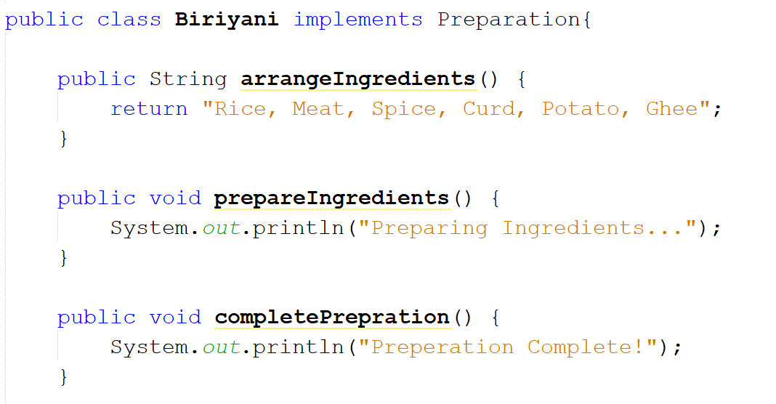

Slide 7
Basic Activities
Assembling
assembleItems
cookItems
finishCooking

Slide 8
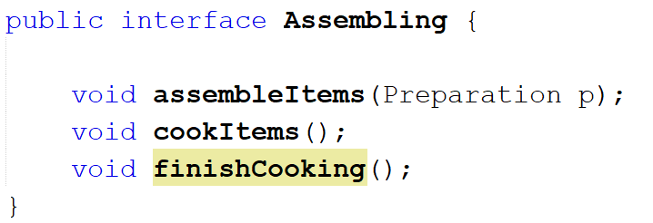
Create an Interface for the 2nd Activity.

Slide 9
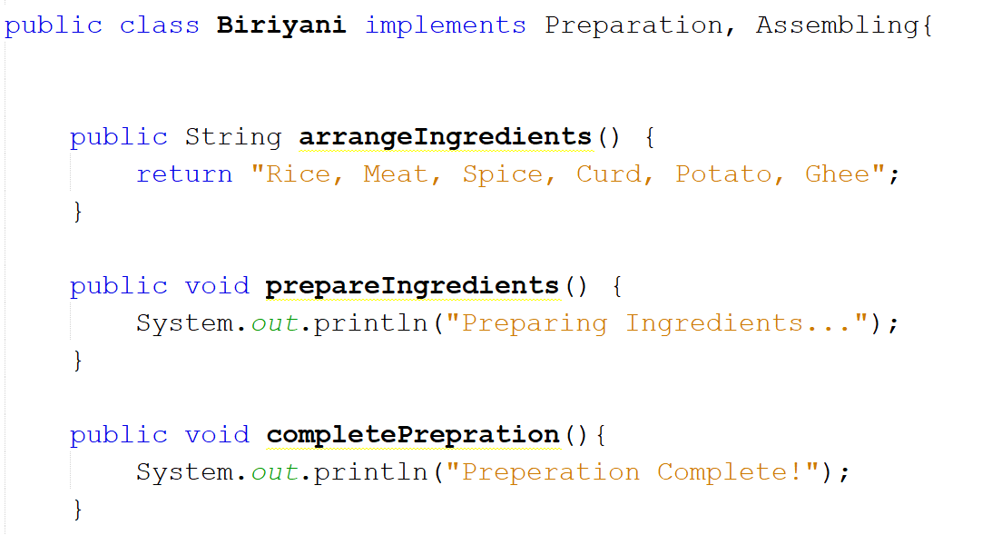

Slide 10
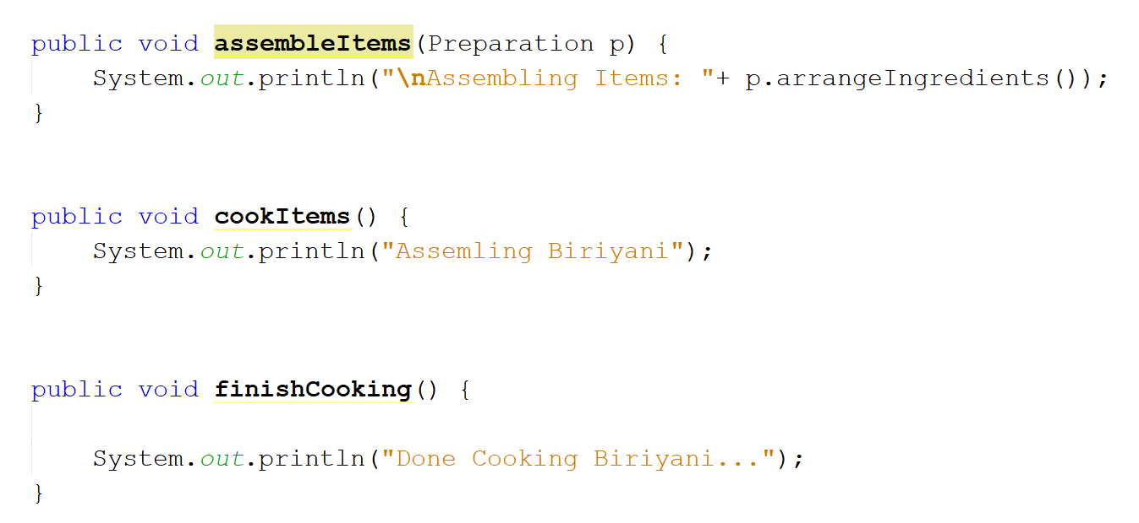

Slide 11
Suppose now we are designing in such a way that in order to sell the product must be prepared and assembled first.

Slide 12
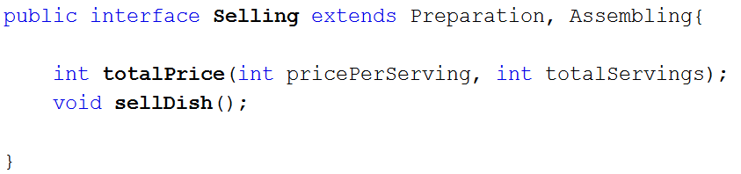
Then we can extend the 2 interfaces to Selling interface.

Slide 13
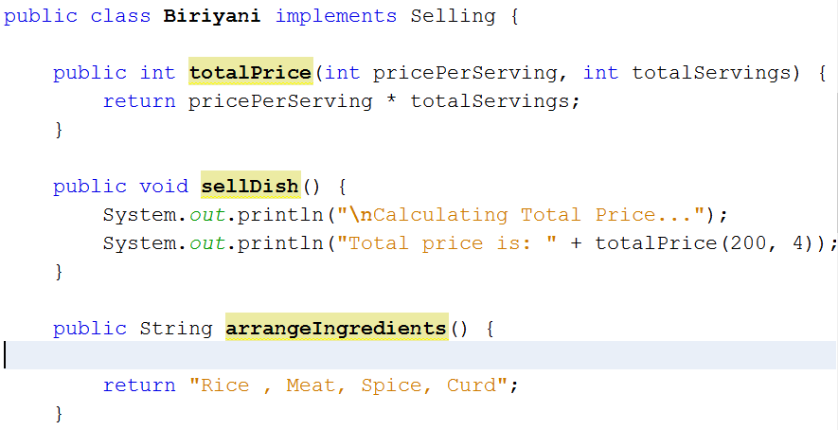

Slide 14
Now if I add another game where we have ready made candy, then will the previously designed Selling interface work? No, it will still force us to assemble and prepare ingredients. So this is a design flaw. Then we can simply delete the extends part.

Slide 15
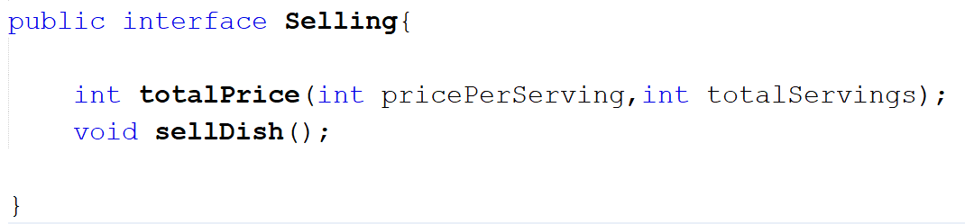
Deleting the extends part and keeping it simple.

Slide 16
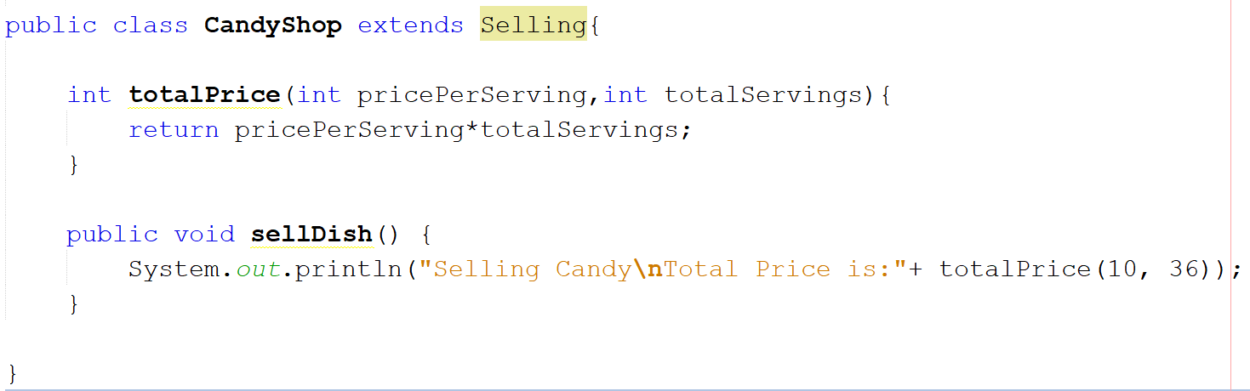
CandyShop can now implement only Selling

Slide 17
Did you notice that the totalPrice() method always return the same formula? If so then wouldn’t it be better if we implement it only once? But Selling also has an unimplemented method. What can we do in this scenario?

Slide 18
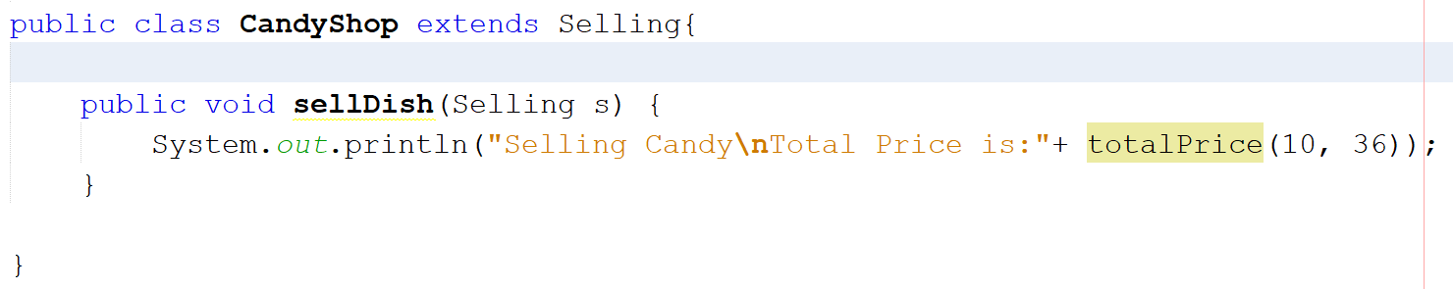
We can simply convert Selling interface to an Abstract class.

Slide 19
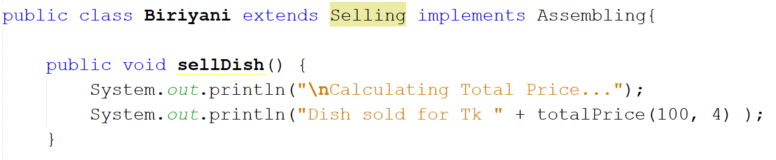
And the Biriyani Class becomes:

